Slide 1

Sofi-Library

Slide 2
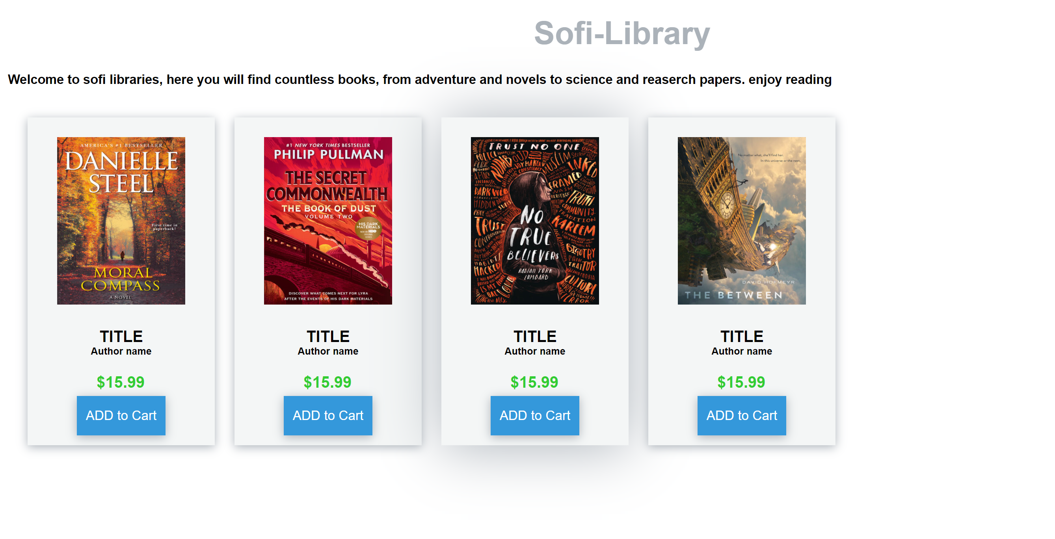
Home page at first login, user will see multiple books from novel to research papers here user can click on book to see description or click on add to cart button to buy it

Slide 3
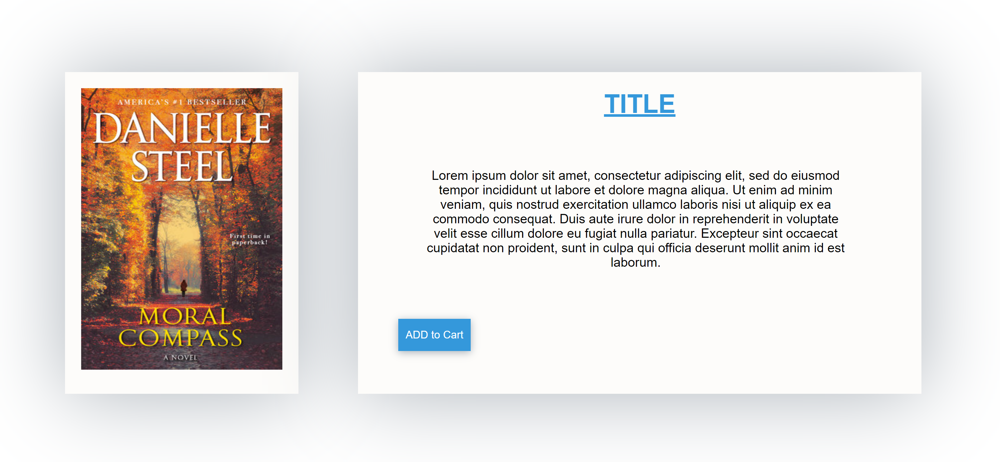
Description here on this page user can see more description about the book in question, user can also buy from description page with the add to cart button

Slide 4
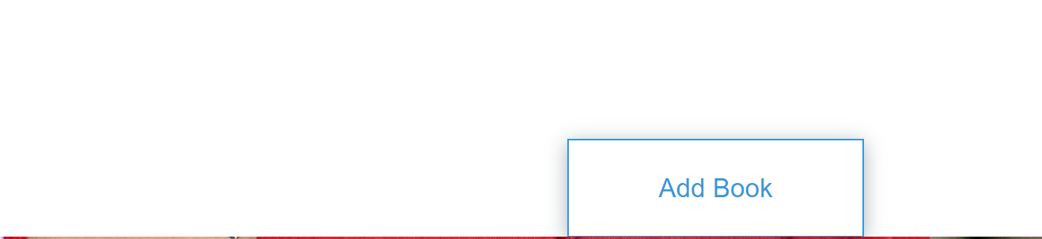
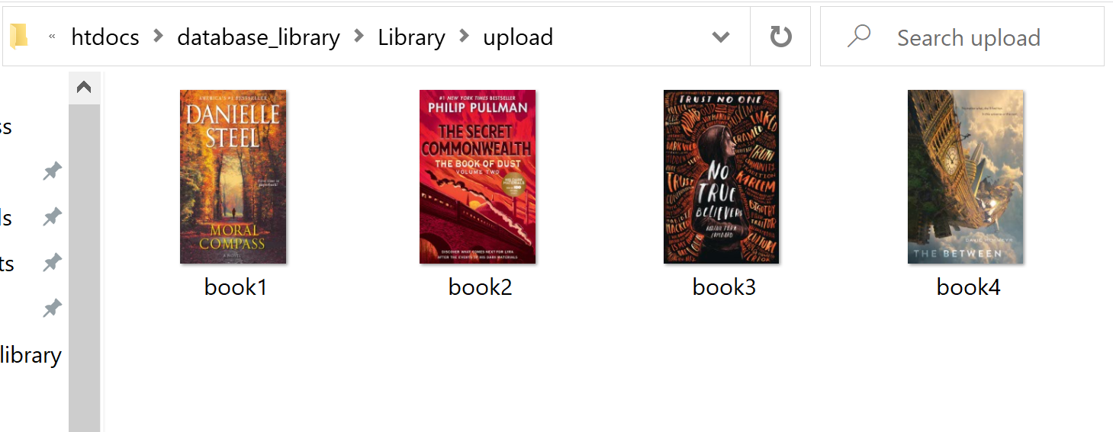
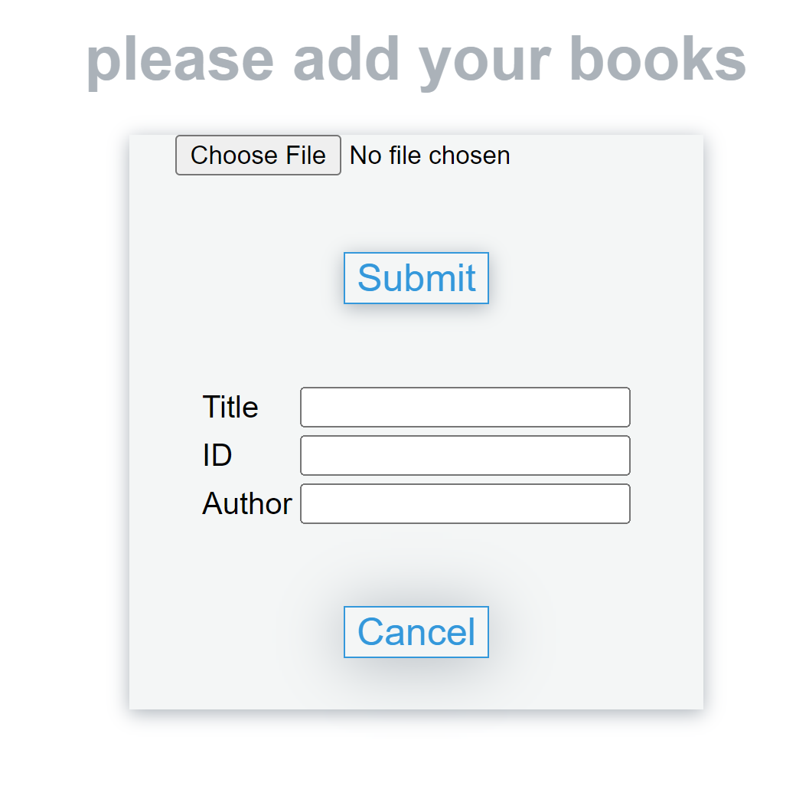
Adding Books using the add button user admin can add books into the system after that admin can enter all required details into the form then by clicking submit book will be added to upload folder.

Slide 5
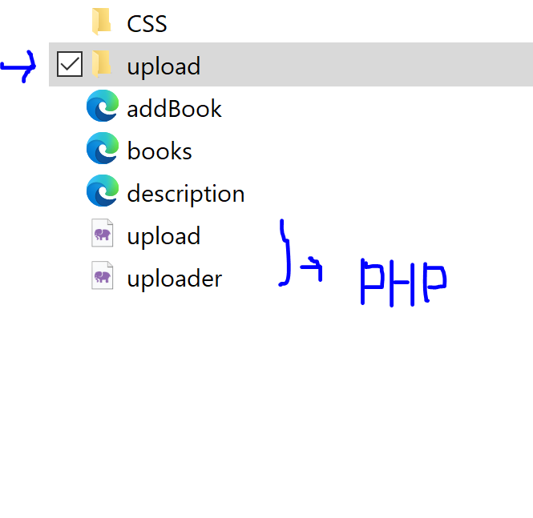
PHP Using PHP backend language the uploader file was created which will be used to create the "choose file" form and to open a window to select an item. using the upload.php file(script) it will allow us to actually move the file from its destination to the upload folder. using xampp I managed to setup a localhost server to run this website.

